Slide 1
Photographic Depth of Field Phillip Island Photographic Society Monday, 3rd October 2022
Bert Hoveling Ph.D.
EFIAP FAPS EFIAP HonFAPS SSAPS SSVAPS
0419 118 610
https://en.wikipedia.org/wiki/Depth_of_field#Factors_affecting_depth_of_field

Slide 2
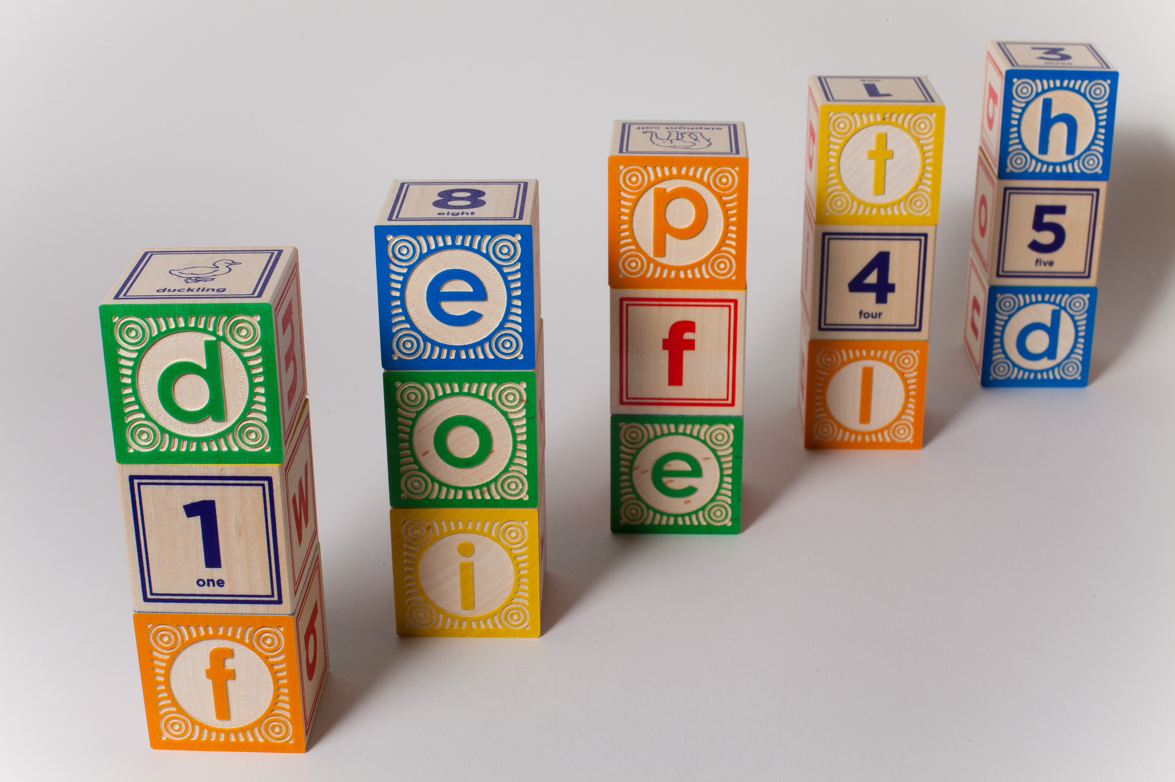
Wikipedia Definition The depth of field (DOF) is the distance between the nearest and the furthest objects that are in acceptably sharp focus in an image captured with a camera.

Slide 5
Key Words
Lens
Focus
Pin Hole Lens
Hyper Focal Distance Focussing
View Camera Techniques
Focus Stacking

Slide 6
Factors Effecting DOF
Lens Selection: Focal Length of the Lens
Lens Selection: Quality of the Lens
Aperture Selected when taking the photographic image
Distance closest and range to objects being photographed to be in focus
Type of Camera used: Mobile; Compact; SLR; Large Format
Use a Tilt/Shift Lens
Exposure: Hand held?; Cable/Remote; Tripod;
Photo Stacking: “in-Camera” or “Post Processing”

Slide 7
Lens Selection: Focal Length of the Lens
Standard Lens - 50 mm
Wide Angle Lens - 14 mm, 28 mm, …. – Higher DOF
Telephoto Lens: - 200mm, 400 mm, 800 mm – Narrow DOF
Macro Lenses – 50 mm. 100 mm, 180 mm
Microscope Lenses ….

Slide 8
Lens Selection: Quality of the Lens
Standard ‘Kit’ lenses – >> “Aberration” – low cost
Multicoated High Quality lenses – Reduced “Aberration” - expensive
Optical Aberration - “Distortion”/”Blurred”/”Soft Focus”
Chromogenic Aberration – “Distortion”/”Blurred”/”Soft Focus”

Slide 9
Optical Aberration
In optics, aberration is a property of optical systems, such as lenses, that causes light to be spread out over some region of space rather than focused to a point.
Aberrations cause the image formed by a lens to be blurred or distorted, with the nature of the distortion depending on the type of aberration.
Aberration can be defined as a departure of the performance of an optical system from the predictions of paraxial optics.

Slide 10
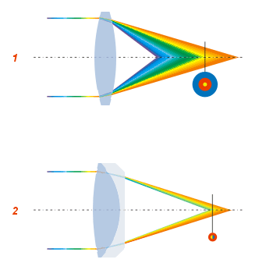
Optical Aberration

Slide 11
Chromogenic Aberration
In optics, chromatic aberration (CA), also called chromatic distortion and spherochromatism, is a failure of a lens to focus all colors to the same point.
It is caused by dispersion: the refractive index of the lens elements varies with the wavelength of light.
The refractive index of most transparent materials decreases with increasing wavelength.^{[2]} Since the focal length of a lens depends on the refractive index, this variation in refractive index affects focusing.
Chromatic aberration manifests itself as "fringes" of colour along boundaries that separate dark and bright parts of the image.

Slide 12
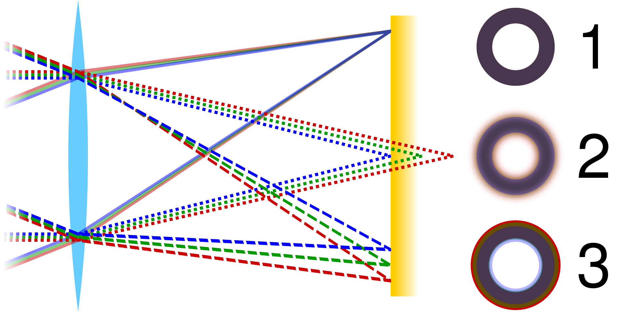

Slide 13
DOF: “Distance closest and range to objects”
Select an aperture which will give you the focussing range –
Check your exposure for the lighting conditions.
If hand held, you might need to increase the ISO for the sensor.
If using a tripod, use a cable release or remote release for long exposures

Slide 14
Aperture Selected when taking the photographic image

Slide 15
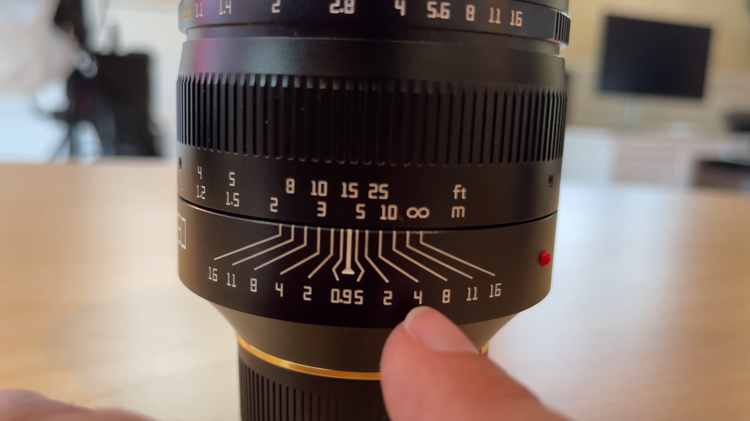

Slide 16
Hyper Focal Distance
In optics and photography, hyperfocal distance is a distance beyond which all objects can be brought into an "acceptable" focus.
As the hyperfocal distance is the focus distance giving the maximum depth of field, it is the most desirable distance to set the focus of a fixed-focus camera.
The hyperfocal distance is entirely dependent upon what level of sharpness is considered to be acceptable.

Slide 17
Hyper Focal Distance Focussing .

Slide 18
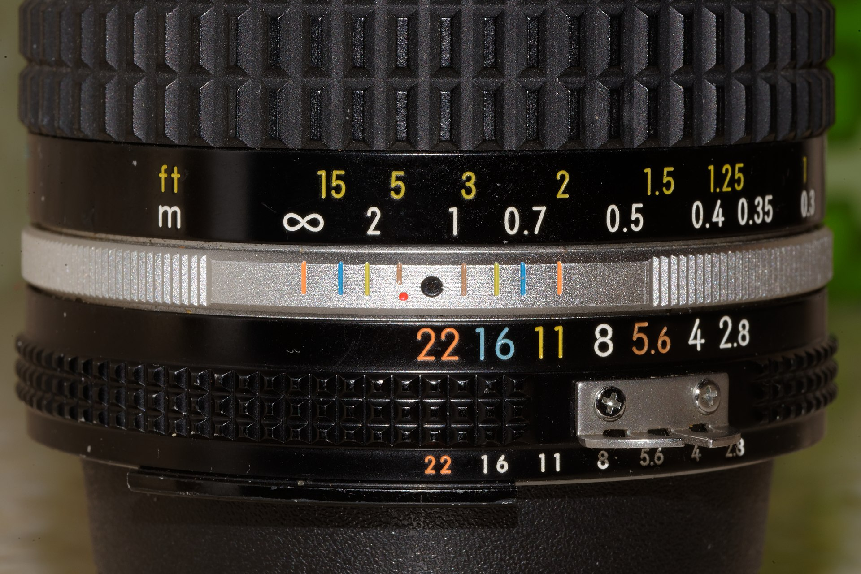

Slide 19
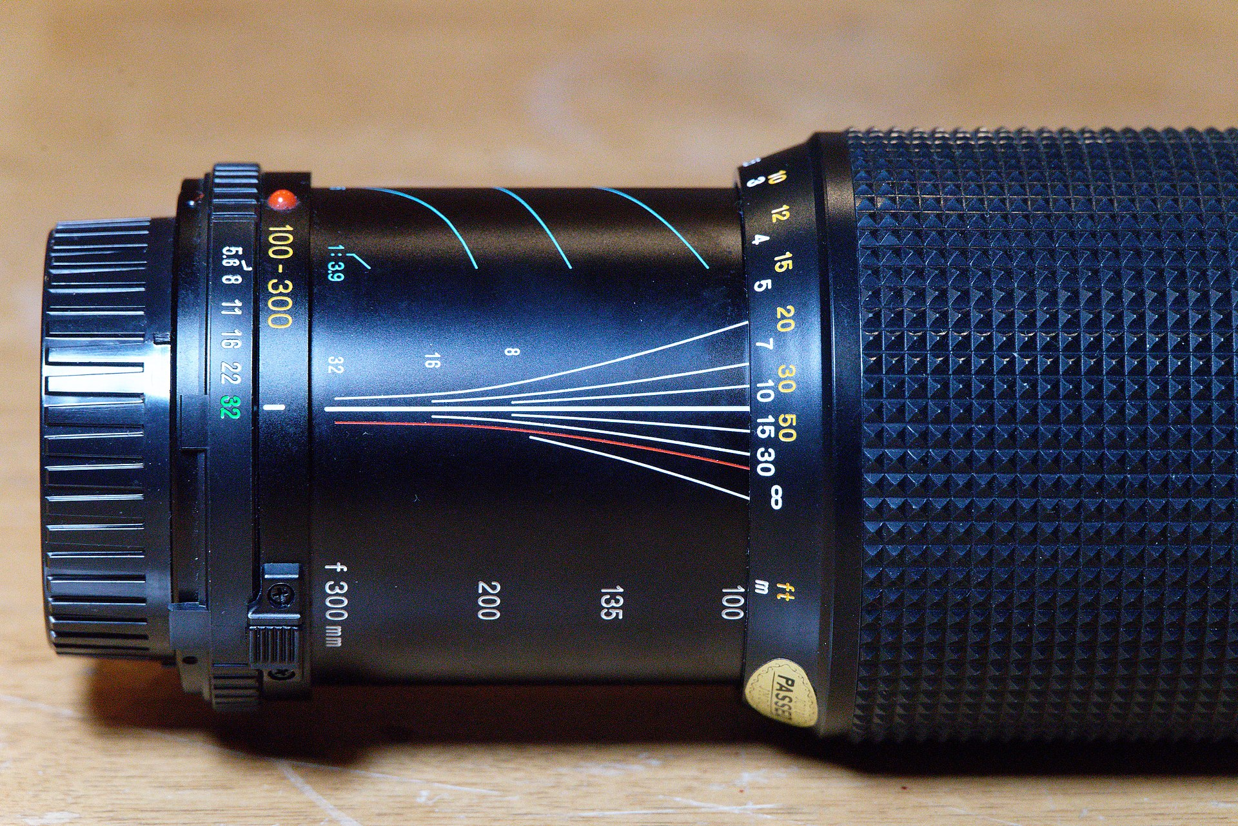

Slide 20
Type of Camera used
Compact Cameras – Lens – Aperture Control/Limited for DOF
SLR Cameras - Lens – Aperture Control/Limited for DOF
View/ Large Format Cameras – Tilt/Shift/Rotate Advantages for DOF and Perspective Correction
Pin-Hole Camera – SLR/Medium Format/Large Format

Slide 21
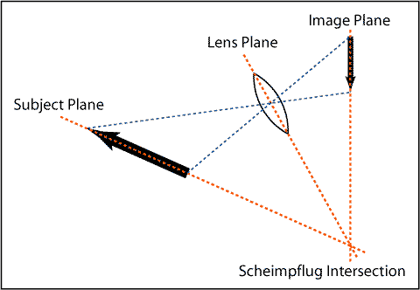
View Camera Controls

Slide 22
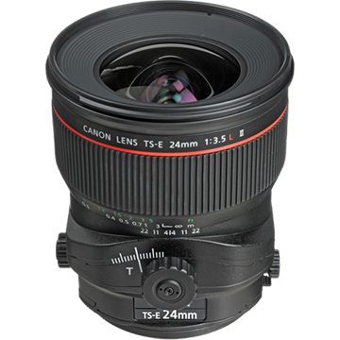
Tilt Shift Lens – Samyang:$1,172; CANON:$3,044

Slide 23
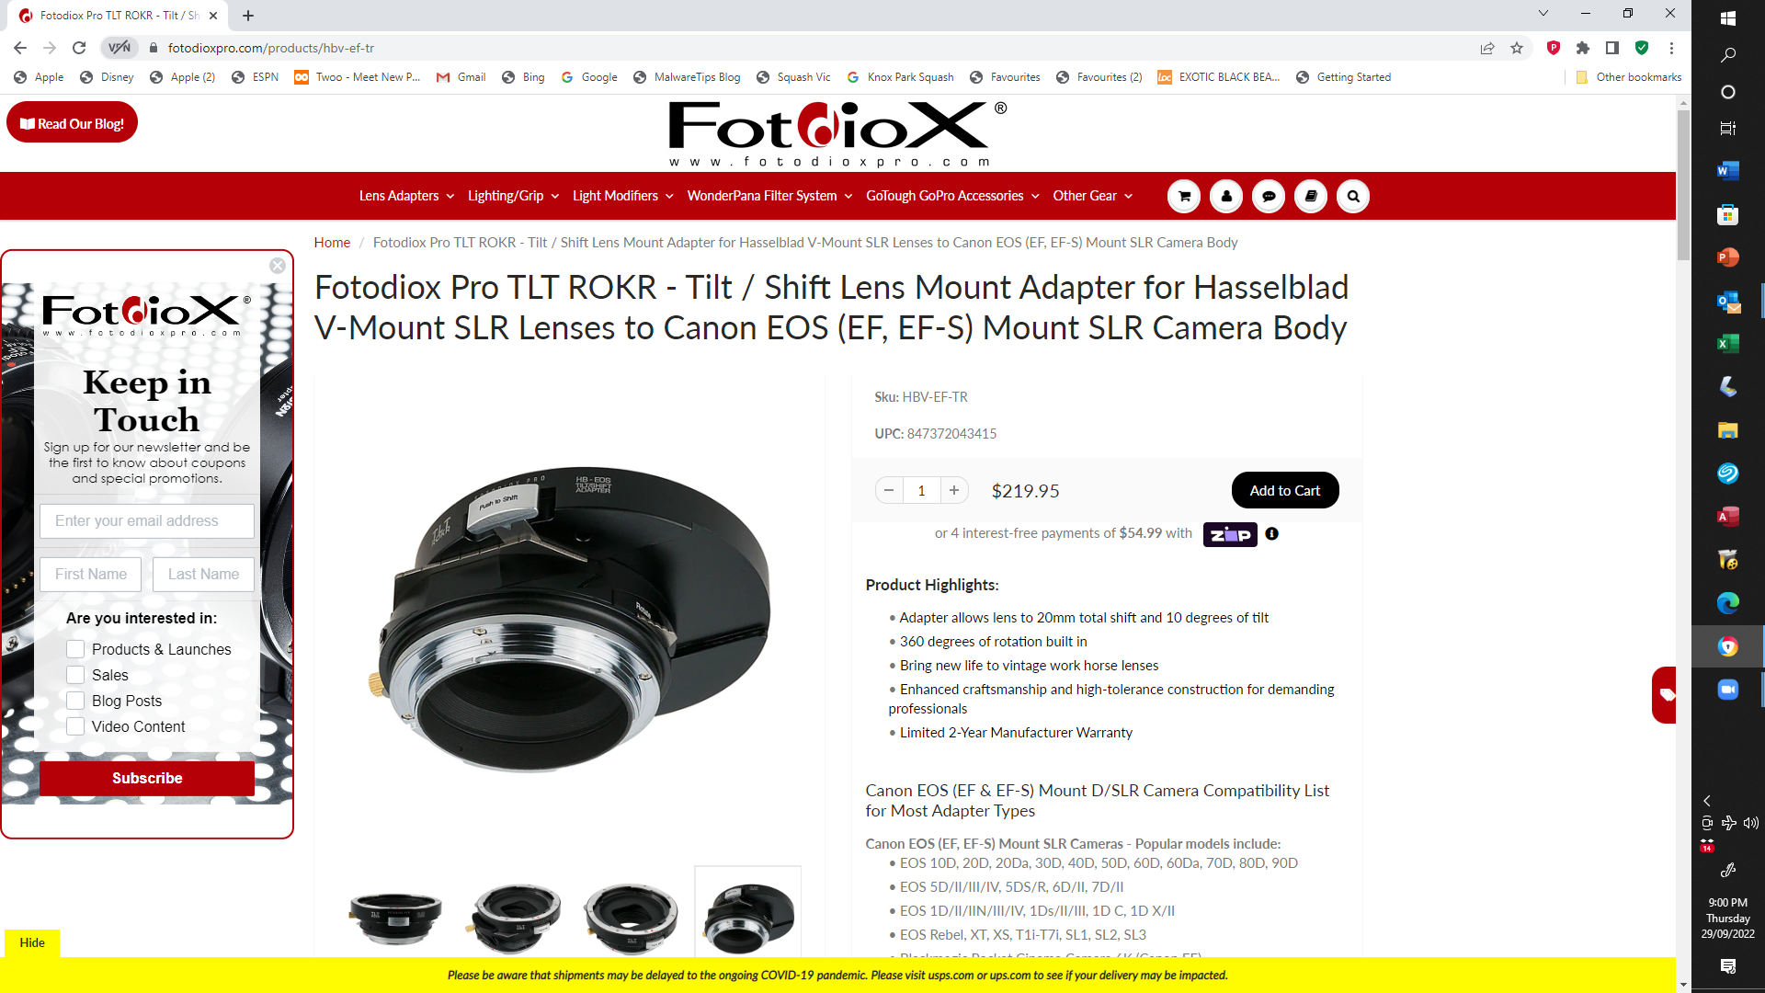

Slide 24
Pin Hole Cameras
Camera Body “Adapter” + 1.0 cm Drilled Hole + “Pin Hole in Alfoil”
Large DOF
Disadvantage – “Soft Focus – compared to Qauality Lens
Applications: “Art Images – Cyanotype, VanDyke Brown – Alternative Emulsions”

Slide 25
Focus Stacking - Technique
Exposure of MULTIPLE IMAGES of the object/scene – without moving the camera – Use a Focussing Rail fine adjustment
MERGING the photos - either manually or with automated software – such as Photoshop…..
EVALUATIING the final “stacked image” – for further “post processing”

Slide 26
Photo Stacking: “in-Camera” or “Post Processing”
Which cameras can create focus stacked images?
1 OM-D E-M1 Mark II. The replacement to the Olympus OM-D E-M1, the E-M1 Mark II brings a higher resolution (20.4Mp) sensor, significantly improved ... 2 OM-D E-M1 (firmware version 4.0) 3 Olympus OM-D E-M5 Mark III. 4 OM-D E-M5 Mark II (firmware version 4.0) 5 OM-D E-M1X. More items

Slide 27
Focus Stacking – for DOF
Macro Photography - Focus Stacking – improved DOF
Landscape – Focus Stacking – improved DOF

Slide 28
Tilt/Shift Lenses Perspective and DOF Assistance
Similar advantages to View Camera Techniques
Better Perspective Control – “Converging Buildings” – Architecture
Better DOF Control (with Aperture Control) – “Landscapes”

Slide 29
Macro Photography DOF
Use a Tripod
Use a Focussing Rail
Use Small Apertures – f/16; f/32..

Slide 30
British Museum Insects Extreme DOF Technique
MICRO PHOTOGOGRAPHY –INSECTS – BRITISH MUSEUM

Slide 32
Check List
Power Point Presentation
Laser Pointers
Catalogues
“Pin Hole Camera”
Large Format – 5 x 4
Tilt/Shift Lens
Lenses
Cameras

